Slide 1

Data storytelling – Starbucks

Slide 2
Business problem
Calories density of caffeinated vs non-caffeinate drinks
Calories density of iced drinks vs hot drinks?
Are Starbucks high on calories?

Slide 3
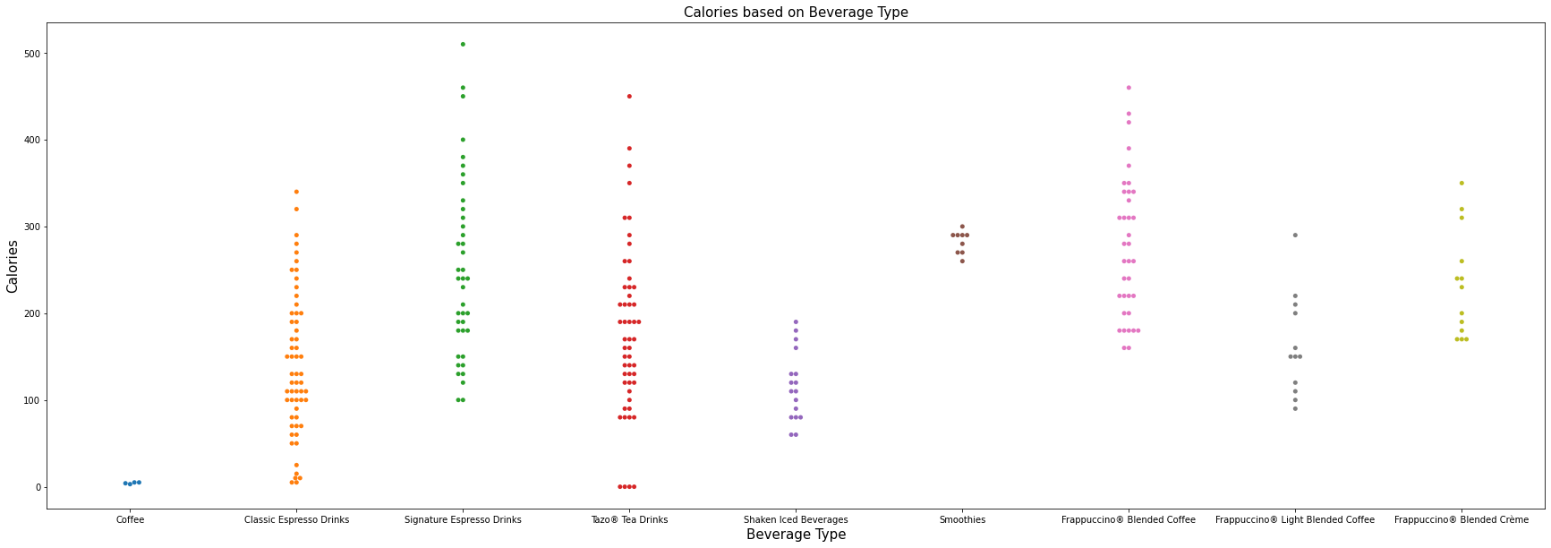
Insight/findings
Key insight from this graph: Frappuccino's and signature drinks have most calories
Iced bev have lower calories than fraps as those options are lower in caloric intake

Slide 4
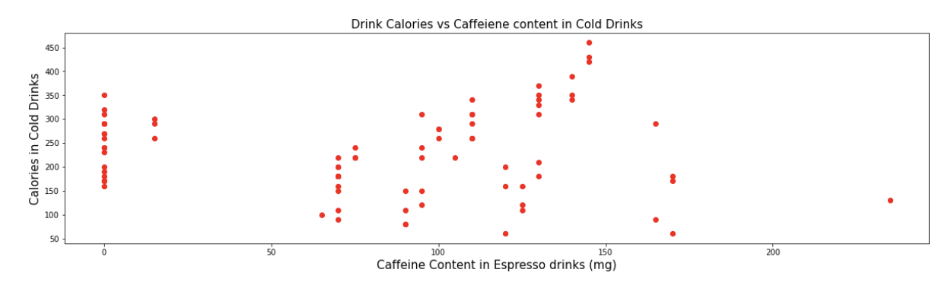
Key insights: caffeine vs calories
Surprising there is no correlation with higher calories with higher caffeine intake.

Slide 5
Conclusion
Findings are if we are looking for less calorie dense drink at Starbucks its best to go for a less sugar and less whip cream drink.
Caffeine amount doesn’t contribute to increase in caloric increase or decrease as it’s a low-calorie factor in the drink compared to milk, froth and whip cream.

